Slide 1


INDUSTRIAL ENGINEERING
FALL 2021
DECISION MODELS
IE 2086
PROF. DANIEL JIANG
Vehicle performance optimization
Report
SUBMITTED BY
SABBELLA PRASANNA
4450873
prs98@pitt.edu

Slide 2
Definitions and terminologies
Deterministic constants
A Normal human can apply a maximum force achievable up to 2000 N with a single leg and only a fraction of which is used to pedal a bicycle continuously. force_capacity = 2000 N F₁ is the constant force that rider 1 can apply = 488 N Fraction force, ^{i}ff = F₁ / force_capacity = 0.244
Mass of the rider i = ^{i}m Assuming the mass of rider 1 = 73 kg
Power of the rider is the amount of energy he is spending per unit time. In other words, the power of the rider is the amount of work he does per unit time. ^{i}P_{j} = Power of rider i on gear j Assuming ¹P₁ = 400 Watt
Power of the rider depletes with time by a certain fraction of amount (pdf – Power Depletion Factor) whose behavior is unknown or random. However, for simplicity in this project, we assume that the power of the rider depletes after every gear change with pdf = 0.05. ^{i}pdf = Power Depletion Factor of rider i power of rider i on gear j = ^{i}P_{j} – (^{i}P_{j} * ^{i}pdf * (j-1))
The vehicle has 7 gears, and the dimensions of each gear/cog are as follows cog_radius_{j} = {j=1:0.068, j=2:0.046, j=3:0.042, j=4:0.038, j=5:0.034, j=6:0.03, j=7:0.026}
On every gear j the rider i spends a specific amount of time ^{*i}t_{j} under constant acceleration and travels a distance ^{*i}d_{j} during this time. Though the rider can practically skip this time and change to next gear, these values are assumed to be non-zero for the sake of avoiding complications in the modeling of this project. ^{*i}t_{j} = f ( F_{i} , cog_radius_{j} , ^{i}m , ^{i}P_{j} ) and ^{*i}d_{j} = f ( F_{i} , cog_radius_{j} , ^{i}m , ^{i}P_{j} ) Description of how this function (simulator) works is not provided in this document, however the formulations can be seen in the code file.

Slide 3
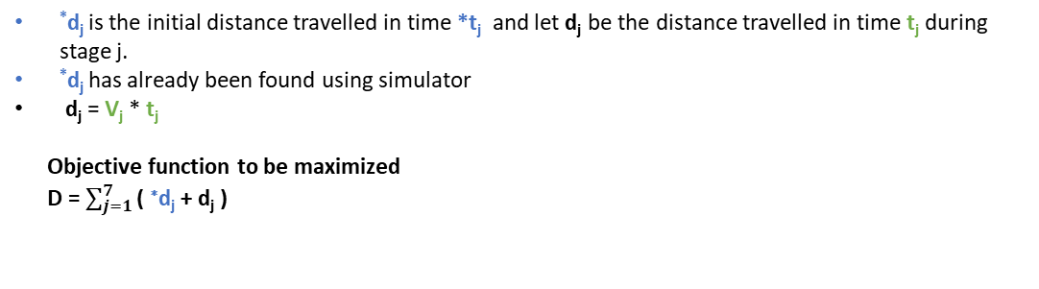
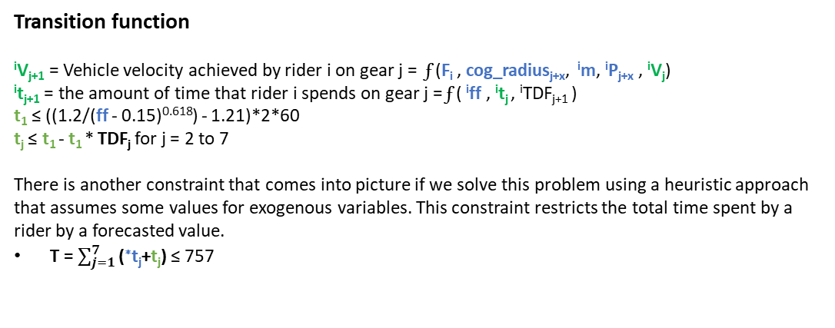
State Variables
There are 7 gears on which the rider can shift to. Each gear or cog is recognized by its radius.
Given the deterministic constants and cog radii the speed/velocity of the vehicle associated with a specific gear can be calculated using basic kinematics and engineering mechanics knowledge.
^{i}V_{j} = Vehicle velocity achieved by rider i on gear j
^{i}t_{j} = the amount of time that rider i spends on gear j
Decision Variables
Each shift in gear is considered as a stage. The decision variable would be whether to shift a gear at a given point in time.
x = 0 no gear change happens
x = 1 gear change happens
Exogenous Variables
The amount of time the rider can last on any gear is limited by an equation.
As the rider moves to higher gears this time will reduce by a certain amount (TDF = Time Depletion Factor) which is random. ^{i}TDF_{j+1} is not known during stage j.
For the sake of optimization ^{i}TDF_{j} = {j=1:1, j=2:0.32, j=3:0.38, j=4:0.44, j=5:0.5, j=6:0.55, j=7:0.61}
Transition function
^{i}V_{j+1} = Vehicle velocity achieved by rider i on gear j = f (F_{i} , cog_radius_{j+x}, ^{i}m, ^{i}P_{j+x} , ^{i}V_{j})
^{i}t_{j+1} = the amount of time that rider i spends on gear j = f ( ^{i}ff , ^{i}t_{j} , ^{i}TDF_{j+1} )
t₁ ≤ ((1.2/(ff - 0.15)^{0.618}) - 1.21)*2*60
t_{j} ≤ t₁ - t₁ * TDF_{j} for j = 2 to 7
There is another constraint that comes into picture if we solve this problem using a heuristic approach that assumes some values for exogenous variables. This constraint restricts the total time spent by a rider by a forecasted value.
T = $\sum_{j=1}^{7}{\text{(}\text{∗}\text{t}\text{j}\text{+}\text{t}\text{j}\text{)}}$ ≤ 757
Contribution function
^{i}d_{j} is the distance travelled by rider i on gear j under constant velocity. We would like to maximize the sum of all distances.
^{i}d_{j} = f (^{i}V_{j} , ^{i}t_{j})
*d_{j} is the initial distance travelled in time *t_{j} and let d_{j} be the distance travelled in time t_{j} during stage j.
*d_{j} has already been found using simulator
d_{j} = V_{j} * t_{j}
Objective function to be maximized
D = $\sum_{j=1}^{7}{\text{( }\text{∗}\text{d}\text{j}\text{ + }\text{d}\text{j}\text{ )}}$

Slide 4
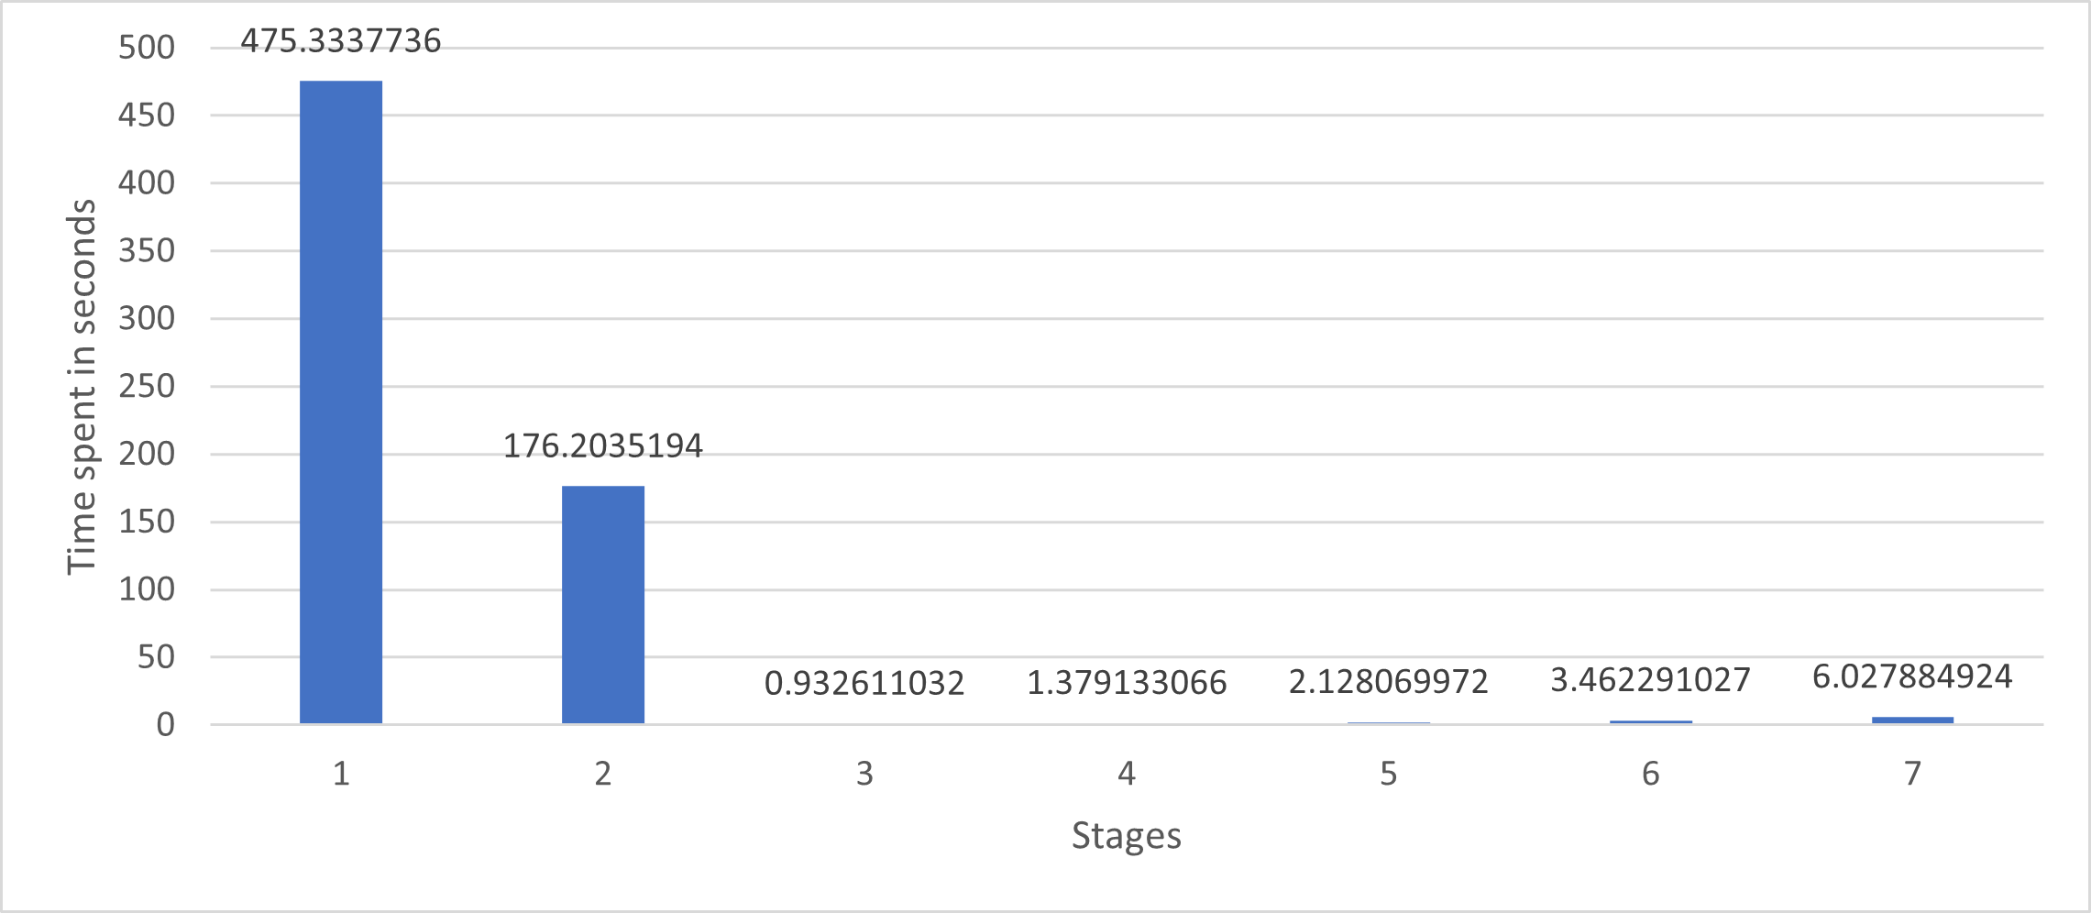
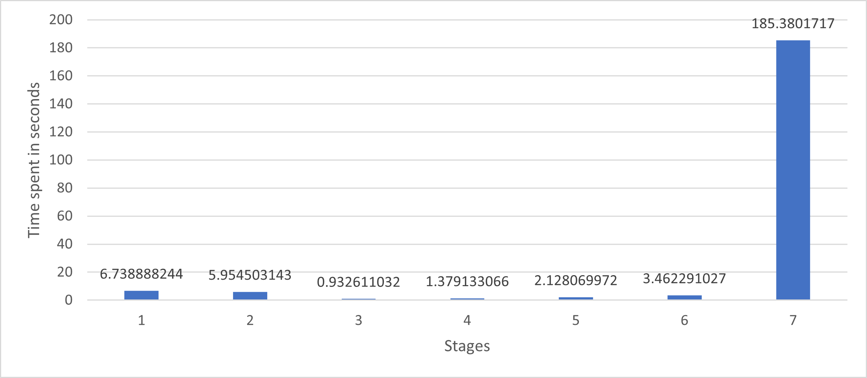
Three ways of policy approach.
Risk-averse heuristic :Risk-averse approach (Solved using Gurobi)
The rider is not willing to take risk and tries to avoid higher gears in a fear of receiving a higher TDF_{j}
Shifts from a gear only when the time exceeds the limit on that gear
Stage 1
Stage 2
Stage 3
Stage 4
Stage 5
Stage 6
Stage 7
D = 3732 m
Greedy approach (Solved using Gurobi)
The rider rides on the highest gear possible as he knows that the velocity is maximum. The rider
comfort in high speed and hopes that he will cover more distance though the TDFj is higher
(i.e. his ride does not last long)
Stage 1
Stage 2
Stage 3
Stage 4
Stage 5
Stage 6
Stage 7
D = 2356 m

Slide 5
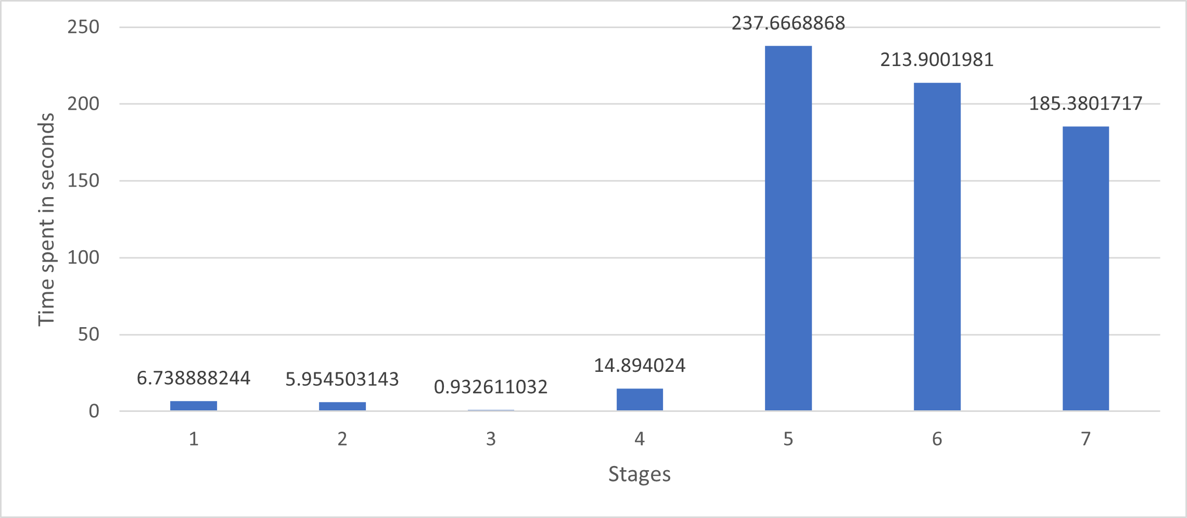
Fixing random variables (Solved using Gurobi)
The rider now has full knowledge of TDF_{j}
TDF_{J} = {j=1:0, j=2:0.32, j=3:0.38, j=4:0.44, j=5:0.5, j=6:0.55, j=7:0.61}
Rider chooses gears wisely
Stage 1
Stage 2
Stage 3
Stage 4
Stage 5
Stage 6
Stage 7
D = 6867 m
Deviation from actual problem statement
This sequential decision model is built around the fact that the mathematical modelling applies only to individual riders and an optimized distance value is found for a specific rider. In this case we considered the rider attributes such as his force, power and mass as constants/deterministic variables.
The same steps can be repeated to other riders and a total cumulative distance can be calculated. The endurance race usually lasts for a specific amount of time. This constraint is not considered into account, and we are assuming that the last rider stops at any stage if the total race time elapsed will reach the deadline.
Drawbacks in the problem setting
A rider is not allowed to shift to a lower gear through out the race. X = -1 is not defined in this model.
Riders cannot skip a gear and will have to ride until atleast time ^{*i}t_{j} . It is after this time ^{*i}t_{j} , the vehicle reaches to maximum velocity.
This problem is potentially a continuously staged problem, but we have it staging discretely on every gear change.
The race circuit is considered as a straight line. A closed circuit has turns and the rider may need to shift to lower gears during turns which in this problem is restricted.

